Slide 1
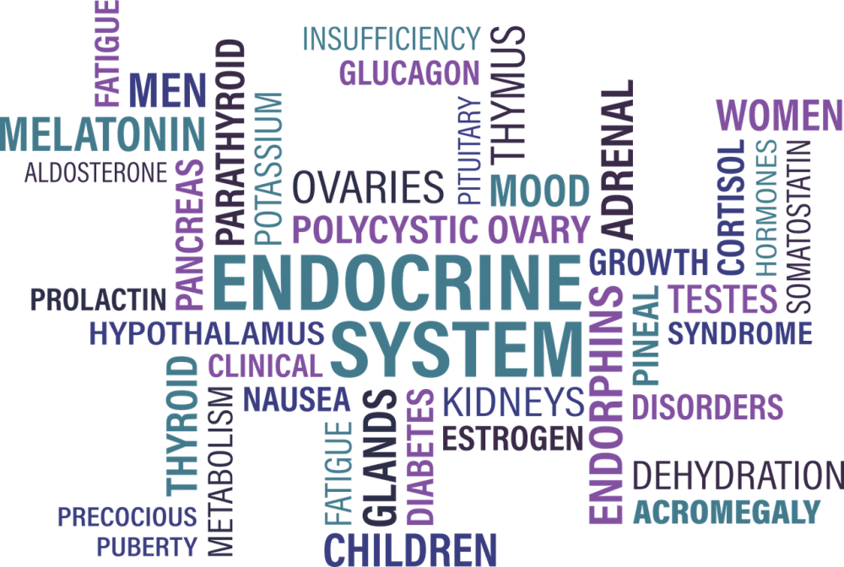
ENDOCRINOLOGY
Dr. Hari Sankar V
Associate Professor,

Slide 2
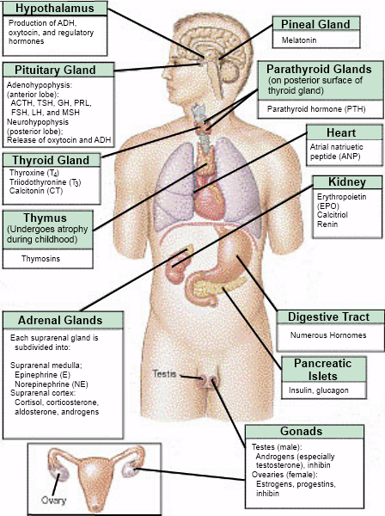
Approximately 10% of the population in India suffers from endocrine/metabolic diseases other than diabetes mellitus and the proportion of various endocrine/ metabolic diseases is given below.
• Goiter 54%
• Diabetes mellitus 20%
• Hormone related reproductive disorders 10%
• Adrenal/pituitary disorders 4%
• Nutritional/metabolic disorders 10%
The prevalence varies from states to states as well as cities and villages.

Slide 3
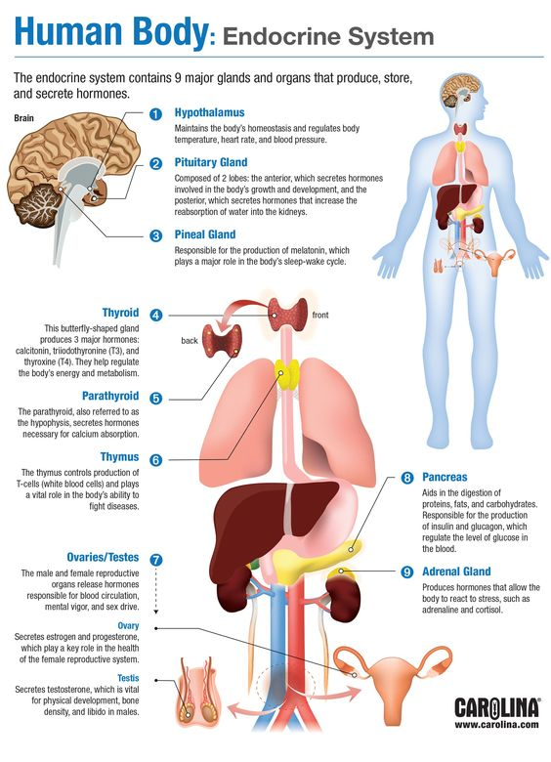
Hormones can be chemically classified as peptides,steroids and amines.
Functions :
1. Maintenance of cellular constancy of the body.
2. Maintenance of the constancy of body fluids (microhomeostasis).
3. Control of metabolic processes.
4. Growth and differentiation of tissues.
5. Reproduction and
6. Adaptation to changes in the external environment (fluid, food, and electrolyte availability).

Slide 4
Clinical Aspects of Endocrine Disorders
Symptomatology
Endocrine disorders may manifest with dysfunction of the gland at fault or secondary disturbances in other endocrine glands.
Sometimes the presenting symptom may be a remote effect due to defective regulation of a metabolic process.
The structural changes in the endocrine glands do not always correlate with the severity of dysfunction.

Slide 5
SYMPTOMATOLOGY
Abnormalities of growth
Endocrine dwarfism
Excessive height
Obesity
Polyphagia
Loss of weight
Non-specific symptoms
Fatigue and weakness
Polyuria
Skin changes
Vitiligo (hypopigmentation of the skin)
Pallor
Abnormalities of hair
Loss of hair (alopecia)
Gynecomastia
Galactorrhea
Disorders of sexual maturation
Precocious puberty
Delayed puberty (infantilism)
Disturbance of sexual function
Skeletal manifestations
Urinary calculi
Tetany
Psychiatric symptoms

Slide 6
Physical Examination
The total clinical effect produced by an endocrine disturbance is determined by the age of onset, severity of hormone dysfunction, duration of the disorder, compensatory mechanisms, and the behaviour of the target organs.
Several other factors like generic behaviour, nutritional status, intercurrent illnesses, and therapy modify the expression of symptoms.
Familial incidence is seen in disorders like diabetes mellitus, thyroid disorders, Kallmann’s syndrome and multiple endocrine adenomatosis.

Slide 7
Growth and development: Disorders of growth are common in many endocrine disorders.
Secondary sexual characters: Disorders of sexual development may take the form of sexual precocity, heterosexual signs (appearance of features of the opposite sex), delayed puberty, or regression of secondary sexual characters.
Anthropometry: In addition to height and weight, measurement of skeletal proportions is of great value in diagnosis.
At birth the ratio of the upper segment to the lower segment is 1:7:1 with the pubic symphysis taken as the reference point.
Cardiovascular abnormalities: Various grades of hypertension may be present in pheochromocytoma, hyperaldosteronism and congenital adrenal hyperplasia.
The hypertension may be paroxysmal as in the case of pheochromocytoma or persistent as in the others.
Malignant hypertension occurring in young subjects should raise the possibility of an endocrine cause.

Slide 8
Orthostatic hypotension may be a prominent symptom in Addison’s disease, hypopituitarism, and diabetic neuropathy.
Cardiovascular manifestations may be prominent in thyrotoxicosis and myxedema.
The integument: The texture and pigmentation of the skin should be looked for. Black freckles and ‘café’ au lait’ spots are seen in gonadal dysgenesis, neurofibromatosis, and some types of sexual precocity.
Hirsutism is common in virilizing conditions.
Presence of acne is a sensitive index of excessive androgen activity.
Breasts: Careful examination of breasts for recent change in size, tenderness, pigmentation and galactorrhea is absolutely essential in all cases.
Enlargement and hyperpigmentation of breasts occur in pregnancy, trophoblastic tumours, luteinising tumours, Cushing’s syndrome and estrogen therapy.

Slide 9
Musculoskeletal system: Several endocrine disorders give rise to characteristic abnormalities.
Excessive muscle weakness, hypotonia and localised hypertrophy or atrophy are suggestive of diseases of the thyroid or adrenal cortex.
In juvenile myxedema, hypertrophy of the calf muscle may be present in a few e.g. Hoffmann’s syndrome.
Adrenogenital syndrome is characterized by hypertrophy of the muscles in children – (Infant Hercules).
Myopathy is characteristic of thyrotoxicosis.
Periodic paralysis (episodes of paralysis mainly involving peripheral muscles lasting for few minutes to hours) may occur in thyrotoxicosis, hyperaldosteronism and others.

Slide 10
Ocular manifestations: Exophthalmos (abnormal protrusion of eyeball) and ophthalmoplegia may be present in thyrotoxicosis and pituitary tumours.
Cataract occurring prematurely may point to diabetes mellitus or hypoparathyroidism.
Visual field defects are common in space occupying lesions in the region of the pituitary and hypothalamus.
External genitalia: State of development of the external genitalia gives indication of the hormonal status in the early developmental period.
Bone age: This is a common parameter used for assessing the maturity of the skeleton.
Appearance of the centres of ossification and fusion of epiphyses occur regularly at definite periods during the growth of the individual.
These are under hormonal control.
Abnormalities in the growth of the skeleton provide evidence of endocrine dysfunction.

Slide 11
Laboratory Investigations
1. Quantitative estimation of its hormones and their metabolites.
2. Biochemical tests which reflect the metabolic abnormality, e.g. blood glucose in diabetes mellitus, serum calcium in parathyroid disorders.
3. Imaging procedures which reveal the morphology and function of the endocrine glands and other tissues, and
4. Assessment of the functional reserve of the glands by appropriate stimulation and suppression tests.

Slide 12
Estimation of Hormones and their Metabolites in Body Fluids
The levels of hormones in blood and body fluids are very low.
Non-peptide hormones are present in body fluids in microgram (10–6g) concentration whereas peptide hormones are present only in the range of nanogram (10–9g) or picograms (10–12g) per unit volume.
Several techniques are used for their estimation.
These are:
a. Bioassay,
b. Spectrophotometric and fluorimetric assay,
c. Radioimmunoassay (RIA),
d. Enzyme – linked immunosorbent assay (ELISA) and
e. Chemoluminiscent assay

Slide 13
Commonly used imaging procedures are as follows:
a. Radiography – plain and contrast studies
b. Isotope scanning – dynamic and static studies
c. Ultrasonography of neck, abdomen and pelvis.
d. Computerized tomography,(CT)
e. Magnetic resonance imaging (MRI)
f. Angiography to detect abnormal vascularity
Stimulation and suppression tests:
These are useful to assess the functional reserve and autonomy of the different endocrine glands and integrity of their feedback control

Slide 14
Doubts ?

